Slide 1
PROJECT OVERVIEW
NLP with Disaster Tweets
Mentor: -
Mr. Prateek Maheshwari
Devina Yadav || ENIYA KULSHRESHTHA|| SAMRIDHI PANDEY|| SHRISHTI VERMA

Slide 2
SCOPE
Introduction
Availability of Dataset
Tools for Implementation
Results
Conclusion and future scope
Algorithms

Slide 3
Why Twitter Disaster Analysis ?
Twitter has become an important communication channel in times of emergency.
The ubiquitousness of smartphones enables people to announce an emergency they’re observing in real-time. Because of this, more agencies are interested in programmatically monitoring Twitter (i.e. disaster relief organizations and news agencies).
A primary goal of our work is to capture tweets that relate to a hazard event, regardless of situational awareness.
This type of tweet categorization can be useful both during and after disaster events. During events, tweets can help crisis managers, first responders, and others take effective action. After the event, analysts can use social media information to understand people’s behavior during the event.
This type of understanding is of critical importance for improving risk communication and protective decision-making leading up to and during disasters, and thus for reducing harm.

Slide 4
AVAILABILITY OF DATASET

Slide 5
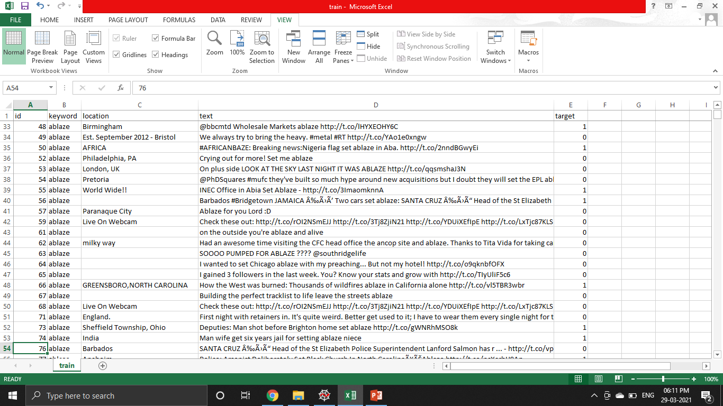
Dataset
Figure Eight Inc. shared their dataset on https://appen.com/open-source-datasets/ and consists of :
The text of tweet
A keyword from the tweet
The location of the tweet

Slide 6
TOOLS FOR IMPLEMENTATION

Slide 7
Specifications
Hardware:
Processor – Intel(R) Core TM i5-6200U CPU @2.30GHz 2.40GHz
RAM – 8GB
System type – 64-bit Operating System, x64-based processor
Software Requirements:
Operating System - Windows 10
GPU – RADEON Graphics
External interfaces / Tools / Libraries:
VSCode, Python Console

Slide 8
DATA-PREPROCESSING

Slide 9
ANAYSIS OF MISSING VALUES
TEXT CLEANING
TOKENISATION
TFIDF

Slide 10
ALGORITHMS

Slide 11
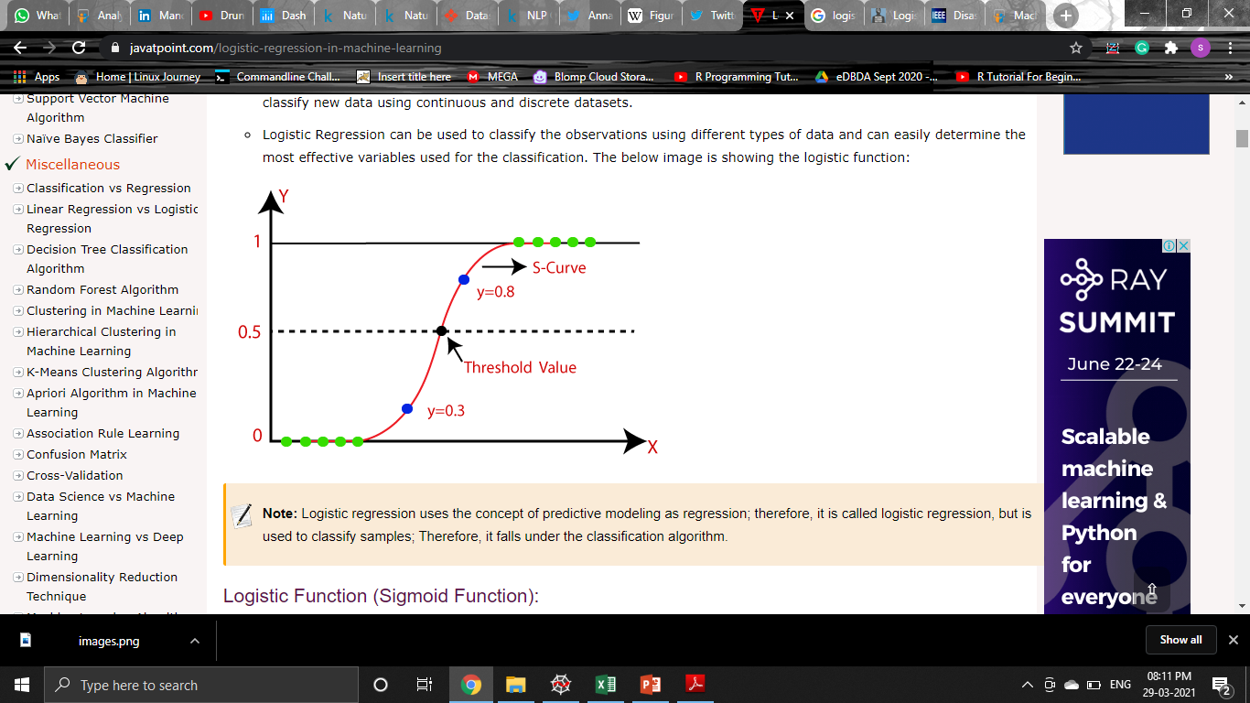

Logistic Regression
Logistic regression is a Classification algorithm used to predict discrete/categorical values.
The Logistic Regression curve is known as the sigmoid curve(S curve).
The Logistic regression equation can be obtained from the Linear Regression equation:
Types of Logistic Regression:
Binomial
Multinomial
Ordinal

Slide 12
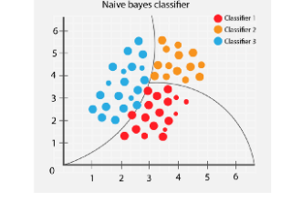

Naive Bayes Algorithm
Naïve Bayes algorithm is a supervised learning algorithm, which is based on Bayes theorem and used for solving classification problems.
Naïve Bayes predicts on the basis of the probability of an object.
The formula for Bayes' theorem is given as:
Where,
P(A|B) is Posterior probability
P(B|A) is Likelihood probability
P(A) is Prior Probability
P(B) is Marginal Probability:

Slide 13
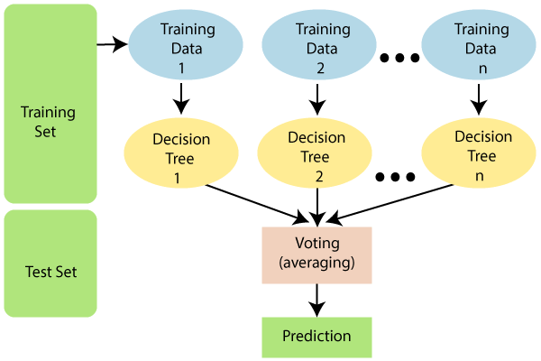
Random Forest Algorithm
Random Forest is a classifier that contains a number of decision trees on various subsets of the given dataset and takes the average to improve the predictive accuracy of that dataset.
The greater number of trees in the forest leads to higher accuracy and prevents the problem of over fitting.

Slide 14

Support Vector Machine(SVM) Algorithm
Support Vector Machine or SVM is one of the most popular Supervised Learning algorithms, which is used for Classification as well as Regression problems.
SVM algorithm can be used for Face detection, image classification, text categorization, etc.

Slide 15
RESULTS

Slide 16
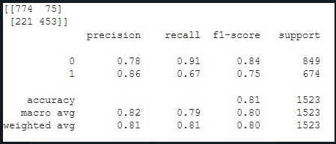
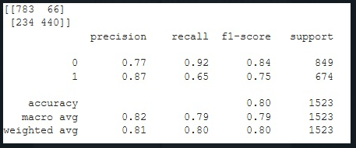
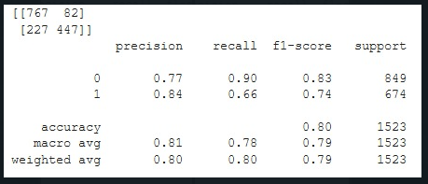
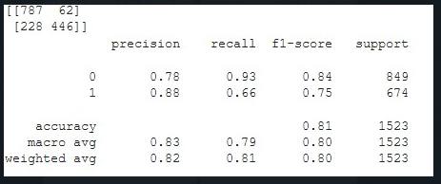
Logistic Regression
Naïve Bayes Algorithm
Random Forest Algorithm
SVM

Slide 17
MODEL EVALUATION | ACCURACY | TIME TAKEN
Logistic Regression | 81% | 6.2 µs
Naïve Bayes Algorithm | 80% | 6.44 µs
Random Forest Algorithm | 79% | 5.72 µs
SVM | 80% | 6.44 µs

Slide 18
CONCLUSION

Slide 19
From the above applied machine learning models, logistic regression gives better accuracy.
So , logistic regression will be used for final prediction.

Slide 20
LIVE STREAMING

Slide 21
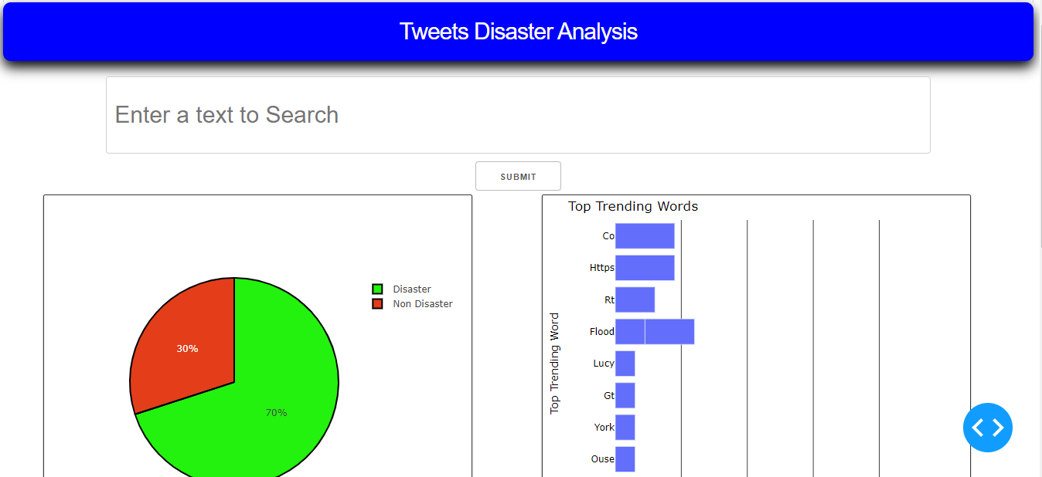

Slide 22
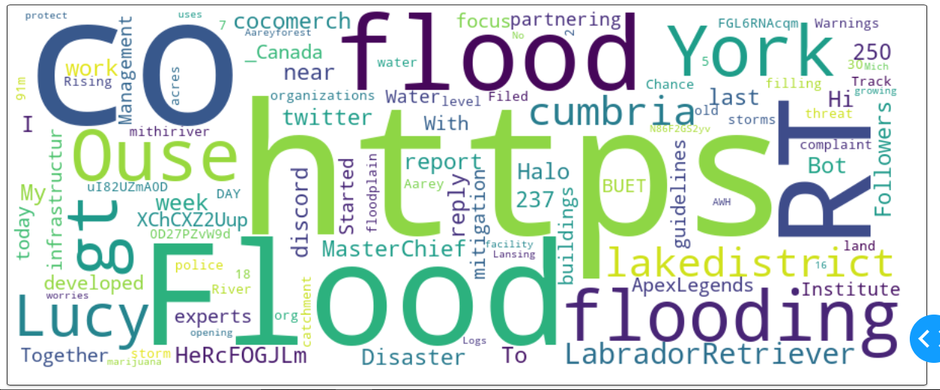

Slide 23
FUTURE SCOPE

Slide 24
Future Enhancements
Trying neural network and deep neural network models such as RNN(Recurrent Neural Network) might result in higher accuracy and better performance.
Analysis of people’s sentiment during a disaster by applying sentiment-analysis on the tweet content.
Involve the use of other popular social networking sites such as Facebook and Google+ in order to increase our database.

Slide 25
THANK - YOU

